Slide 1
HW10
Object Detection Using YOLO v3 Deep Learning
-Parisha Rathod

Slide 2
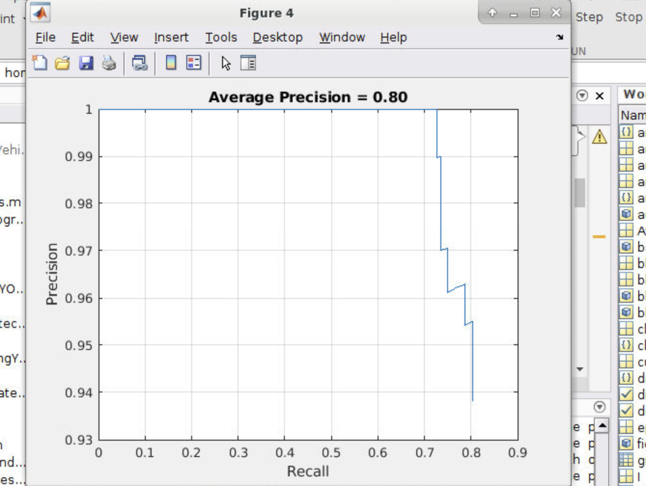
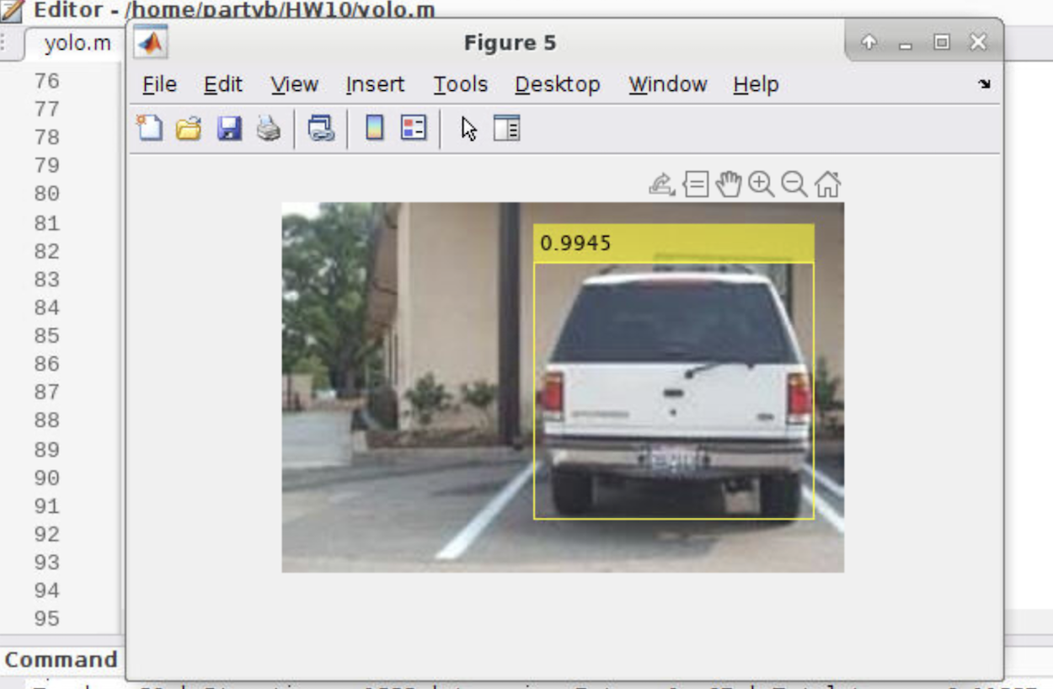
1. Baseline - Epochs 80

Slide 3
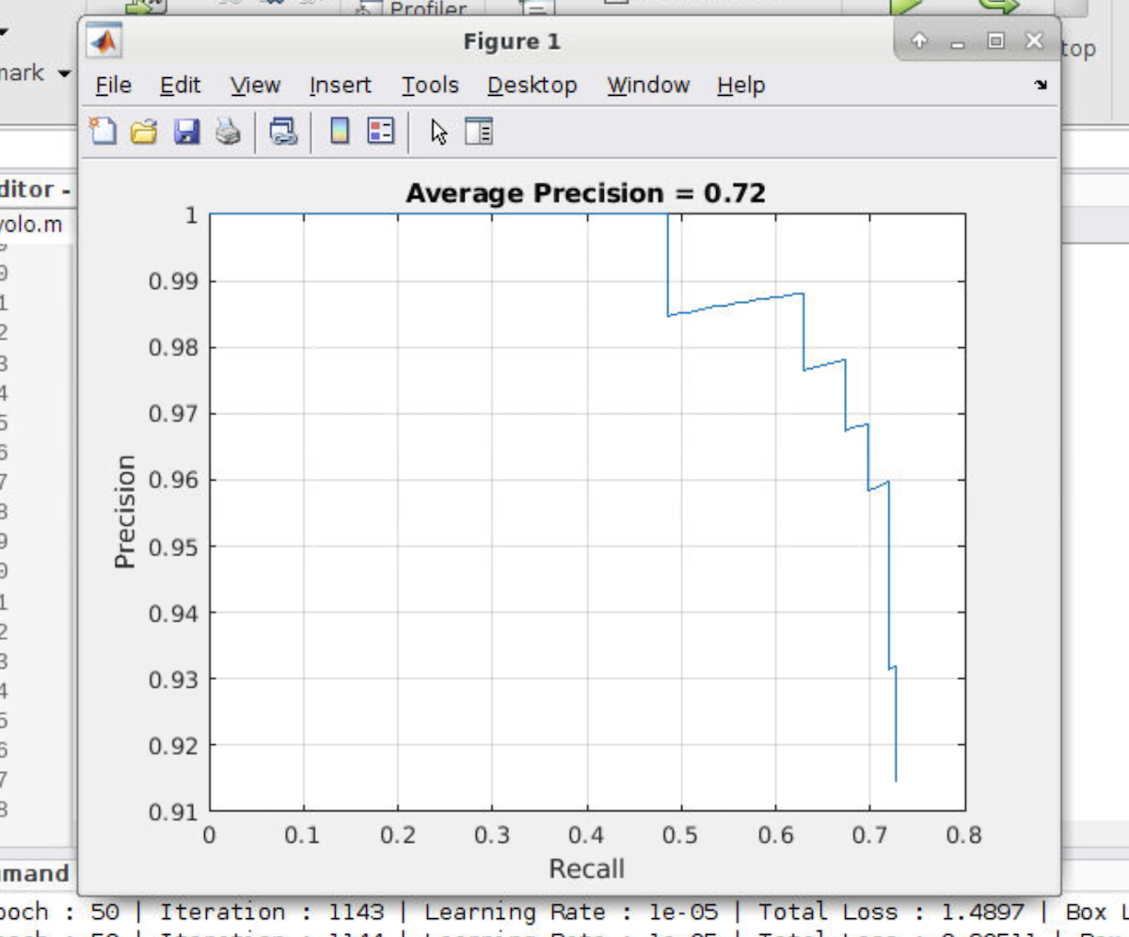
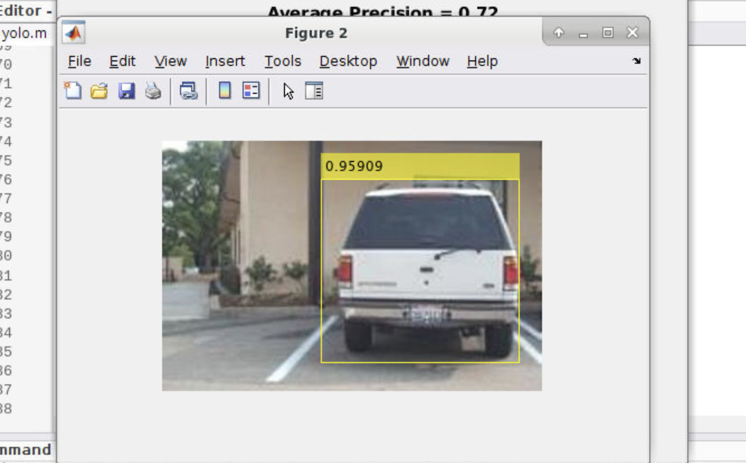
2. Changing Epochs = 50

Slide 4
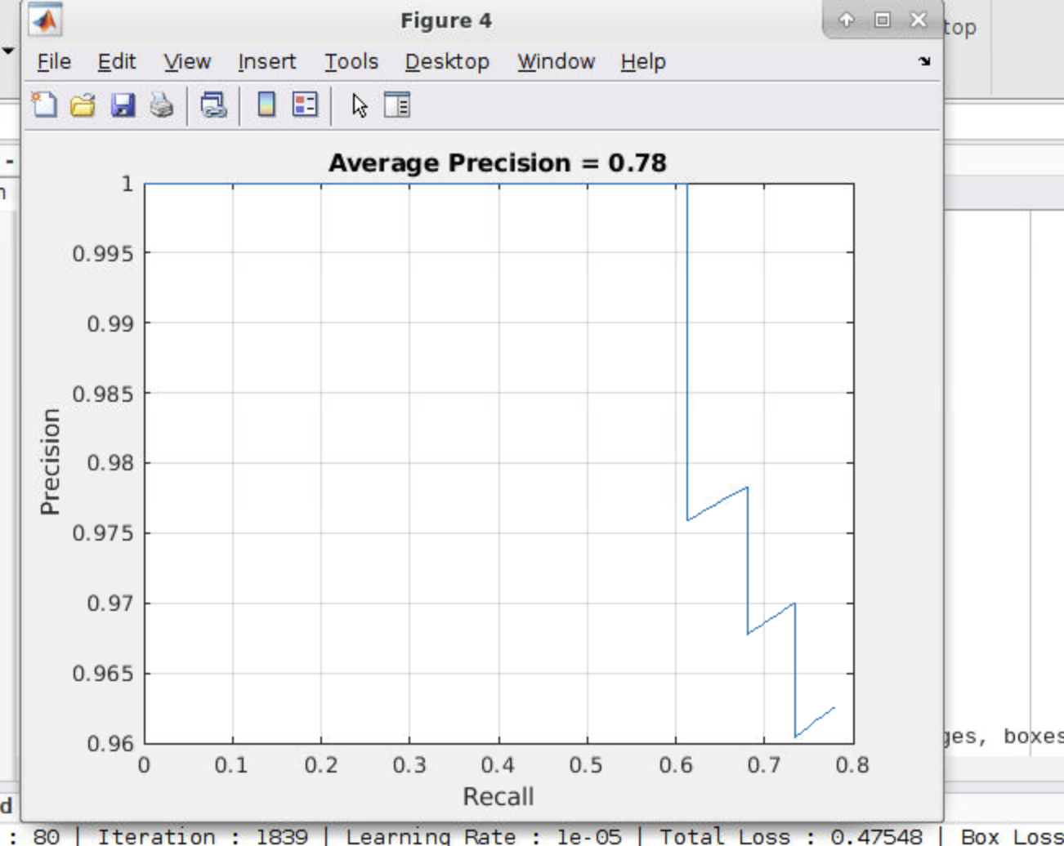
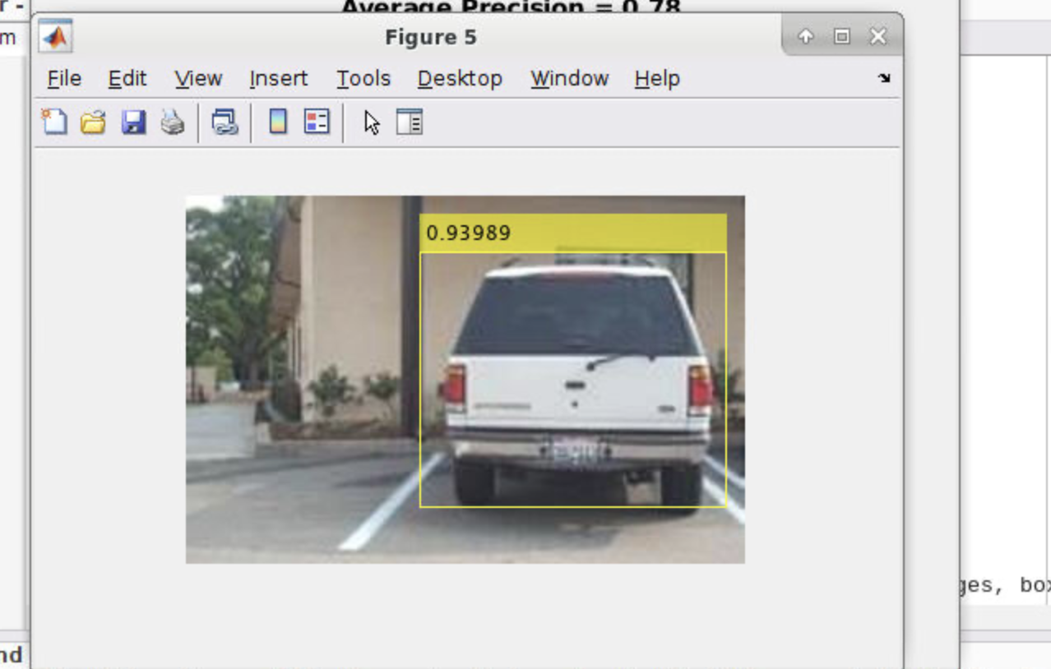
3. Penalty Threshold = 0.7

Slide 5
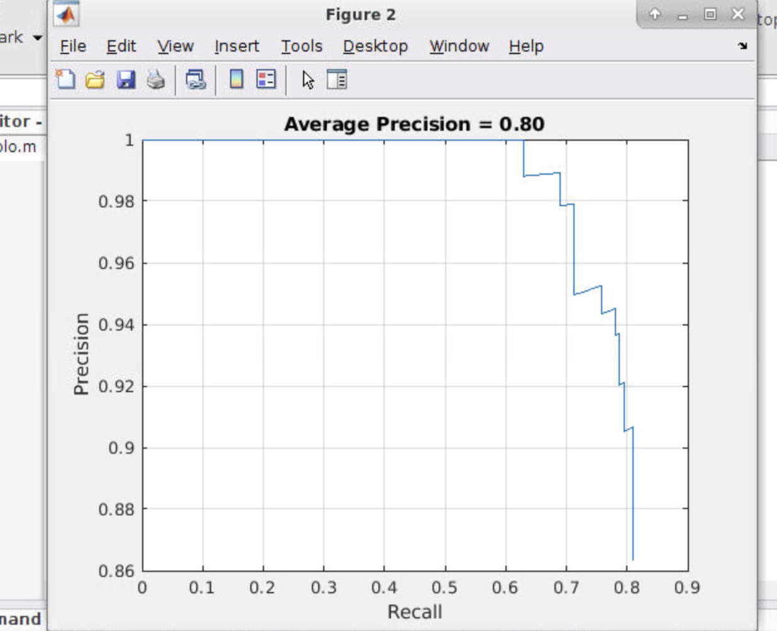
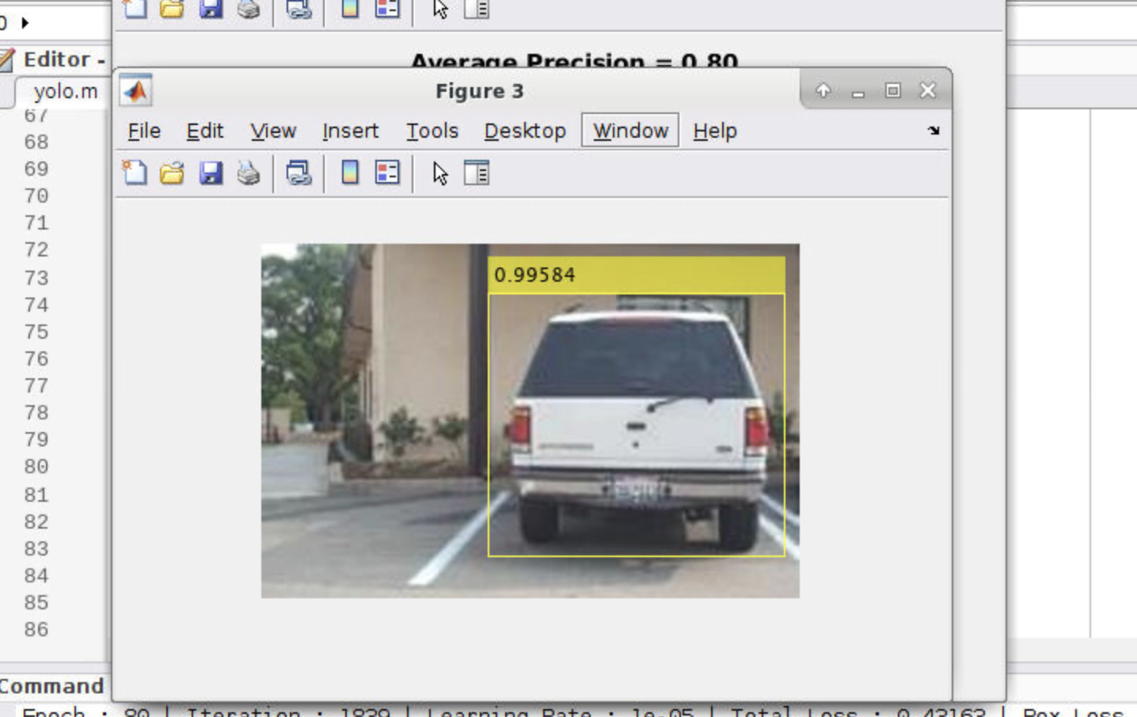
4. Penalty Threshold = 0.3

Slide 6
Comparison
Baseline precision is 80% and decision confidence is 99.45%
When we decrease the number of epochs to 50 average precision also decreases to 72% and decision confidence is 95.9%
Increased the penalty threshold to 0.7 from 0.5 gave 78% average precision and decision confidence was 93.89%
Decreased the penalty threshold to 0.3, gave average precision of 80% and decision confidence of 99.58%
In conclusion, number of epochs equal to 80 and penalty threshold of 0.5 and 0.7 gave better average precision of 80% and decision confidence of more than 99%

